Slide 1
1

Slide 2
OBJECTIVES
Define forking and other operations with GitHub
Identify the process to clone a repository
Explain GitHub Pages
Describe different types of GitHub Pages sites
List the guidelines for using GitHub Pages
2

Slide 3
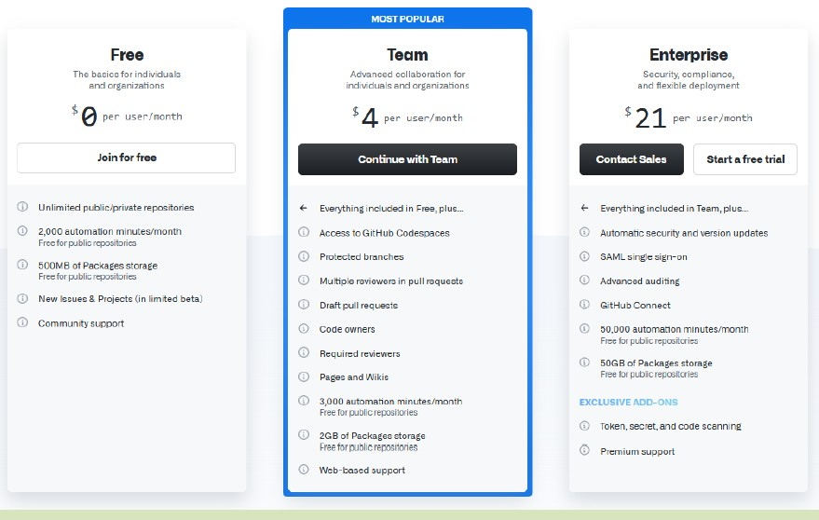
GITHUB PRICING PLANS
Using GitHub in Project Implementation
Advanced features useful for enterprises
Remote access
Quality management
Collaboration
3

Slide 4
FORKING AND OTHER OPERATIONS WITH GITHUB 1-2
Process of forking
Basic sequence in forking
Login into GitHub account
Fork acts as a bridge between the original repository and the
user's personal copy
Select existing repository and click Fork symbol
Use ‘Commit’ to save changes
Merge changes into original repository
Forking the public repositories
4

Slide 5

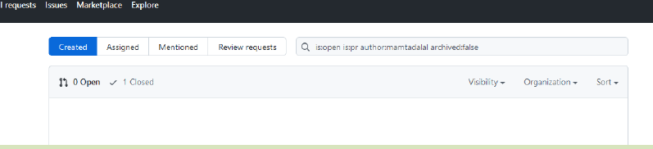
FORKING AND OTHER OPERATIONS WITH GITHUB 2-2
^{Deleting a local branch} Restoring a Deleted branch
Merging and deleting using Pull requests

Slide 6
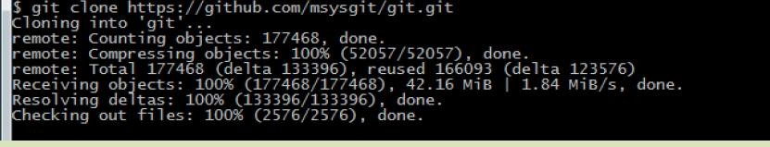
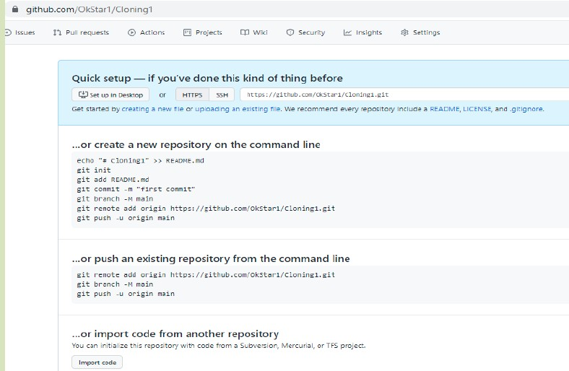
CLONING A REPOSITORY
Copying the repository from GitHub.com to the local machine
Add/Remove files and fix Merging issues

Slide 7
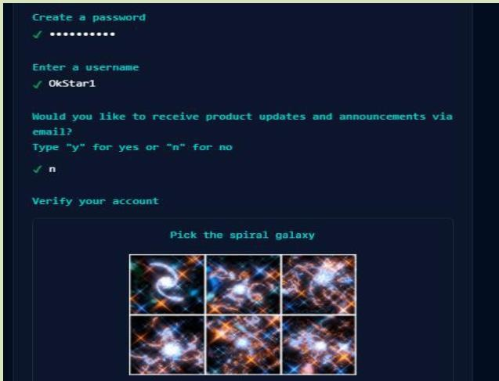

INTRODUCTION TO GITHUB PAGES
Use of GitHub Pages
GitHub Pages Creation
Steps for creating GitHub pages

Slide 8
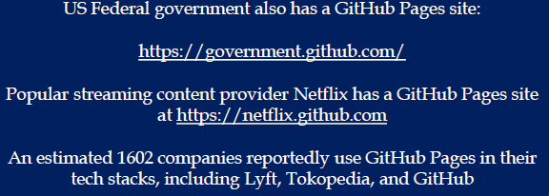
TYPES OF GITHUB PAGES SITES 1-2
Types of GitHub Pages
Project
User
Organization

Slide 9
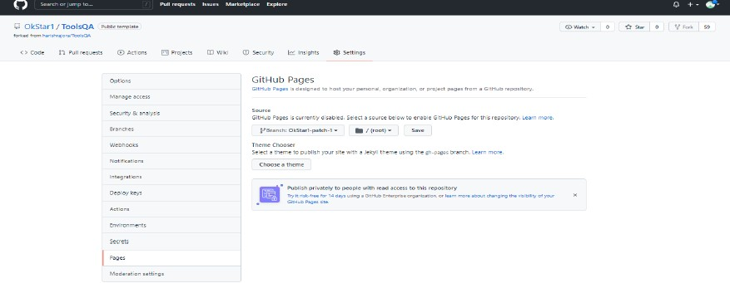
TYPES OF GITHUB PAGES SITES 2-2
Adding Theme to a Page Site
Creating GitHub Pages sites
Once repository is created, users can add theme
Edit as per users requirements
Verification will be done once modification is completed
Steps to add theme to a Page site

Slide 10



GUIDELINES FOR USING GITHUB PAGES
Designed to host users personal and organizational project pages
Simplicity and Security is managed by host provider
Prohibiting/Selling/Re
selling information

Slide 11



LIMITATIONS OF USAGE
GitHub Pages source repositories have a limitation of 1 GB
Published sites cannot exceed more than 1 GB
Agree to Terms and Conditions of GitHub Pages
Allows users to create only one Organization/Users

Slide 12
SUMMARY
Free, Team, and Enterprise are the three major types of accounts
Enables to perform remote access, quality management, and collaboration
Forking creates a copy of the repository
Merging accepts changes from the forked repository into the
original repository
• Cloning is the process of creating a copy of the repository
12

